Slide 1
SOA final project
Prof. Bilgin Esme
By Murhaf Sousli

Slide 2

Introduction
The app is a about a basic users manager where client can get/add/update/delete users.
Backend technologies:
WordPress API.
PHP to configure the service.
Frontend technologies:
Angular2 framework.
Typescript (superset of a Javascript).
HTML5.
Sass (powerful extension of CSS3).

Slide 3
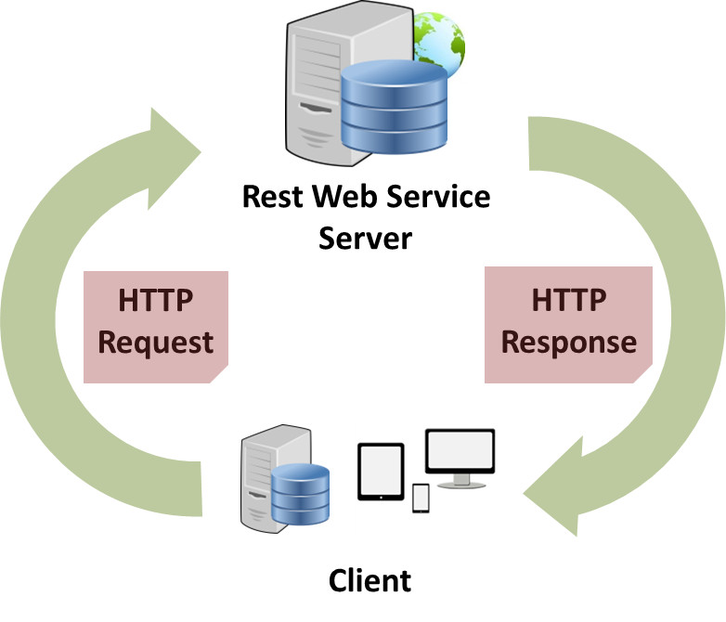
Introduction
I’m using JSON for the response type.
I’m using 3 services classes to consume different REST endpoints:
Endpoint to Authenticate and Authorize users (who is using our client app).
Endpoint to get a collection of users
Endpoint to GET/ADD/UPDATE/DELETE a single user

Slide 4
AuthService
Our authenticate service will send POST request to the authenticate endpoint
http://localhost/wordpress/wp-json/jwt-auth/v1/token
If our request succeed we will get a json response for our AuthUser interface
After that we will be redirected to the Home Page.
export interface IAuthUser{ id; user_display_name; roles; }

Slide 5
WpCollection Service
This service is meant to retrieve a collection of users.
By sending a GET request on the url http://localhost/wordpress/wp-json/wp/v2/users
Our expected response will be a json which holds an array of User Class
export class User { name:string; url:string; description:string; password:string; username:string; email:string;
.
.
}

Slide 6
WpModel Service
This service is meant to retrieve a single user by id.
It is used for CRUD operations (Create,Read,Update,Delete).
export class User { name:string; url:string; description:string; password:string; username:string; email:string;
.
.
}

Slide 7
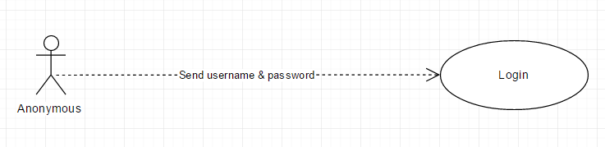
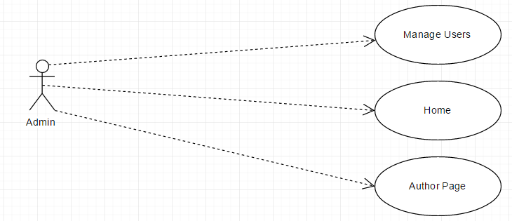
App use cases

Slide 8
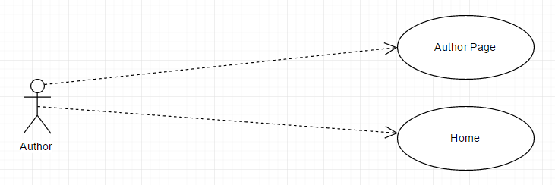
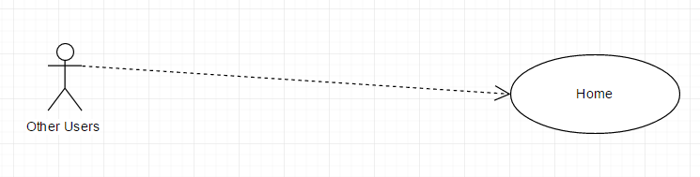
App use cases

Slide 9
App functions
A signed in admin user will be able to do the following:
Get a list of all registered users.
Add a new user.
Update an existing user.
Delete an existing user.
Access to all pages.
View any user profile.
Logout

Slide 10
Summary
We start by going to site domain (http://localhost:3000).
Anonymous users will be redirected to the login page.
The user enters his username and password, if logging in succeed, he will be redirected to the main page.
There are 4 pages available, Home, Author, Manage Users, About
Inside Manage Users page there are 3 child pages:
add user
update user
list users.

Slide 11
Let’s see the Demo

